Slide 1

Cognitive Psychology: Thinking, Intelligence, and Language
Chapter 8

Slide 2
Chapter 8 Learning Objective Menu
LO 8.1 How people use mental images to think
LO 8.2 Nature of a concept
LO 8.3 Methods people use to solve problems and make decisions
LO 8.4 Artificial intelligence
LO 8.5 Barriers to solving problems
LO 8.6 Creative thinking
LO 8.7 Definition of intelligence
LO 8.8 How intelligence tests measure intelligence
LO 8.9 How intelligence tests are constructed
LO 8.10 Mental retardation and what causes it
LO 8.11 Giftedness
LO 8.12 Does intellectually gifted guarantee success
LO 8.13 Theories of intelligence and how they differ
LO 8.14 Influence of heredity and environment on intelligence
LO 8.15 Language
LO 8.16 Elements and structure of language
LO 8.17 Language’s influence on thinking
LO 8.18 Animal capability of learning language
LO 8.19 Ways to improve thinking

Slide 3
Thinking and Mental Images
LO 8.1 How people use mental images to think
Thinking (cognition) - mental activity that goes on in the brain when a person is organizing and attempting to understand information and communicating information to others.
Mental images - mental representations that stand for objects or events and have a picture-like quality.
Menu

Slide 4
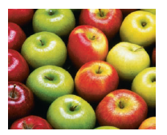
Concepts
LO 8.2 Nature of a concept
Concepts - ideas that represent a class or category of objects, events, or activities.
Superordinate concept - the most general form of a type of concept, such as “animal” or “fruit.”
Basic level type - an example of a type of concept around which other similar concepts are organized, such as “dog,” “cat,” or “pear.”
Menu

Slide 5
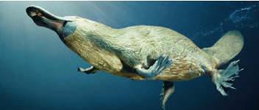
Concepts
LO 8.2 Nature of a concept
Subordinate concept – the most specific category of a concept, such as one’s pet dog or a pear in one’s hand.
Formal concepts - concepts that are defined by specific rules or features.
Natural concepts - concepts people form as a result of their experiences in the real world.
Prototype - an example of a concept that closely matches the defining characteristics of a concept.
A platypus is a “fuzzy” natural concept
Menu

Slide 6
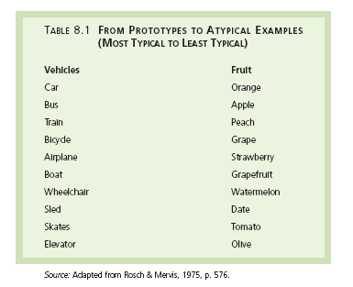
LO 8.2 Nature of a concept
Menu

Slide 7
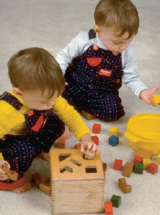
Problem-Solving
LO 8.3 Methods people use to solve problems and make decisions
Problem solving - process of cognition that occurs when a goal must be reached by thinking and behaving in certain ways.
Trial and error (mechanical solution) – problem-solving method in which one possible solution after another is tried until a successful one is found.
Algorithms - very specific, step-by-step procedures for solving certain types of problems.
Menu

Slide 8
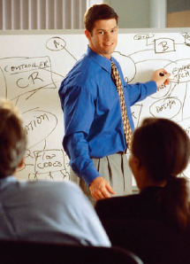
Problem-Solving
LO 8.3 Methods people use to solve problems and make decisions
Heuristic - an educated guess based on prior experiences that helps narrow down the possible solutions for a problem. Also known as a “rule of thumb.”
  Means–end analysis - heuristic in which the difference between the starting situation and the goal is determined and then steps are taken to reduce that difference.
Insight - sudden perception of a solution to a problem.
Menu

Slide 9
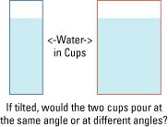
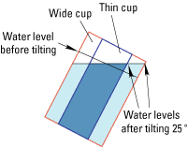
LO 8.3 Methods people use to solve problems and make decisions
Menu

Slide 10

LO 8.3 Methods people use to solve problems and make decisions
Tower of Hanoi
Menu

Slide 11
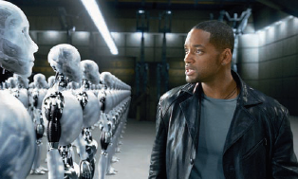
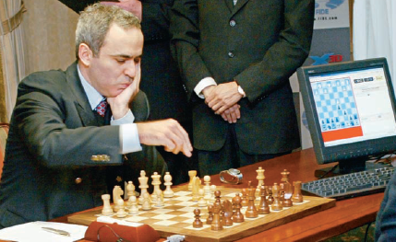
Artificial Intelligence
LO 8.4 Artificial intelligence
Artificial intelligence (AI) - the creation of a machine that can think like a human.
  True flexibility of human thought processes has yet to be developed in a machine.
Menu

Slide 12
Problem-Solving Barriers
LO 8.5 Barriers to solving problems
Functional fixedness - a block to problem solving that comes from thinking about objects in terms of only their typical functions.
Mental set - the tendency for people to persist in using problem-solving patterns that have worked for them in the past.
Confirmation bias – the tendency to search for evidence that fits one’s beliefs while ignoring any evidence that does not fit those beliefs.
Menu

Slide 13

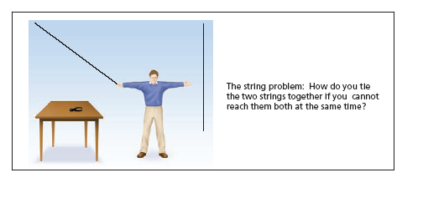
LO 8.5 Barriers to solving problems
Menu

Slide 14

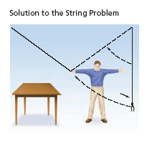
LO 8.5 Barriers to solving problems
Menu

Slide 15
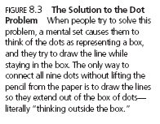
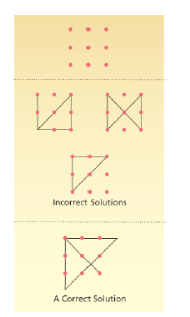
LO 8.5 Barriers to solving problems
Menu

Slide 16
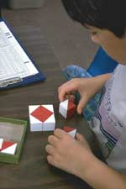
IQ Tests
LO 8.8 How intelligence tests measure intelligence
Intelligence quotient (IQ) - a number representing a measure of intelligence, resulting from the division of one’s mental age by one’s chronological age and then multiplying that quotient by 100.
Stanford-Binet Intelligence Test yields an IQ score.
Wechsler Intelligence Tests yield a verbal score and a performance score, as well as an overall score of intelligence.
Menu

Slide 17
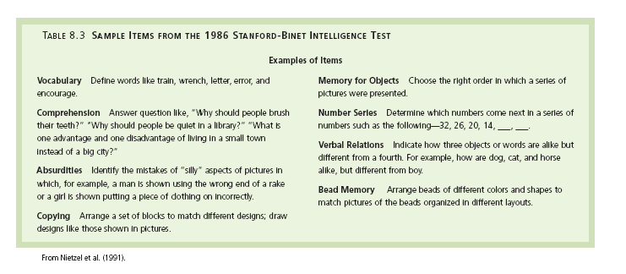
LO 8.8 How intelligence tests measure intelligence
Menu

Slide 18

LO 8.8 How intelligence tests measure intelligence
Menu

Slide 19
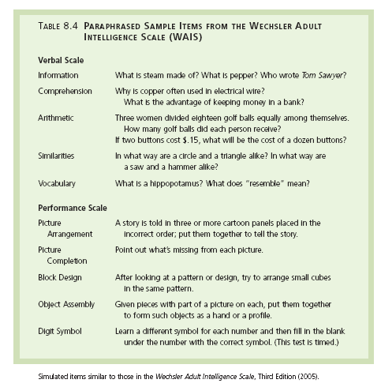
LO 8.8 How intelligence tests measure intelligence
Menu

Slide 20
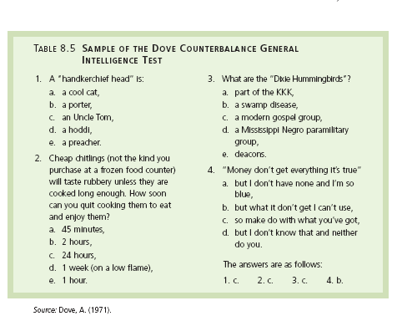
LO 8.8 How intelligence tests measure intelligence
Menu

Slide 21
Intelligence
LO 8.7 Definition of intelligence
Intelligence - the ability to learn from one’s experiences, acquire knowledge, and use resources effectively in adapting to new situations or solving problems.
Menu

Slide 22
Development of IQ Tests
LO 8.9 How intelligence tests are constructed
Standardization - the process of giving the test to a large group of people that represents the kind of people for whom the test is designed.
Validity - the degree to which a test actually measures what it’s supposed to measure.
Reliability - the tendency of a test to produce the same scores again and again each time it is given to the same people.
Menu

Slide 23
Unreliable and Invalid
LO 8.9 How intelligence tests are constructed
Construct (i.e., “intelligence)
TEST
Scores on test
Menu

Slide 24
Reliable But Invalid
LO 8.9 How intelligence tests are constructed
Construct (i.e., “intelligence)
TEST
Scores on test
Test can be RELIABLE but still be INVALID!
Menu

Slide 25
Reliable AND Valid
LO 8.9 How intelligence tests are constructed
Construct (i.e., “intelligence)
TEST
Scores on test
Test MUST be RELIABLE to be VALID!
Menu

Slide 26

Development of IQ Tests
LO 8.9 How intelligence tests are constructed
Deviation IQ scores - a type of intelligence measure that assumes that IQ is normally distributed around a mean of 100 with a standard deviation of about 15.
  Norms
Menu

Slide 27

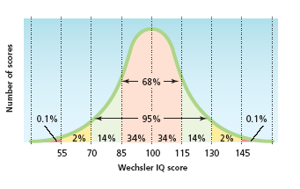
LO 8.9 How intelligence tests are constructed
Menu

Slide 28
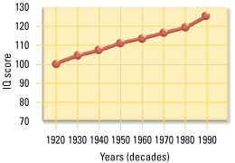
LO 8.9 How intelligence tests are constructed
Menu

Slide 29
Mental Retardation
LO 8.10 Mental retardation and what causes it
Developmentally delayed - condition in which a person’s behavioral and cognitive skills exist at an earlier developmental stage than the skills of others who are the same chronological age. A more acceptable term for mental retardation.
  Mental retardation or developmental delay is a condition in which IQ falls below 70 and adaptive behavior is severely deficient for a person of a particular chronological age.
Menu

Slide 30
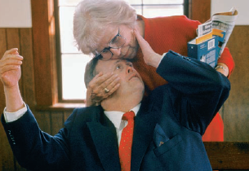
Mental Retardation
LO 8.10 Mental retardation and what causes it
Four levels of delay are:
  Mild: 55–70 IQ
  Moderate: 40–55 IQ
  Severe: 25–40 IQ
  Profound: Below 25 IQ.
Causes of developmental delay include deprived environments, as well as chromosome and genetic disorders and dietary deficiencies.
Menu

Slide 31
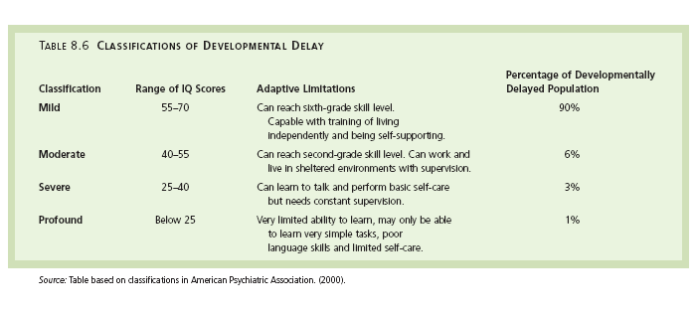
LO 8.10 Mental retardation and what causes it
Menu

Slide 32

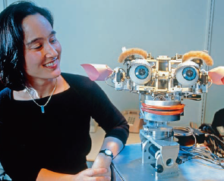
Creativity
LO 8.6 Creative thinking
Creativity- the process of solving problems by combining ideas or behavior in new ways.
  Convergent thinking - type of thinking in which a problem is seen as having only one answer, and all lines of thinking will eventually lead to that single answer, using previous knowledge and logic.
  Divergent thinking – type of thinking in which a person starts from one point and comes up with many different ideas or possibilities based on that point (kind of creativity).
Menu

Slide 33
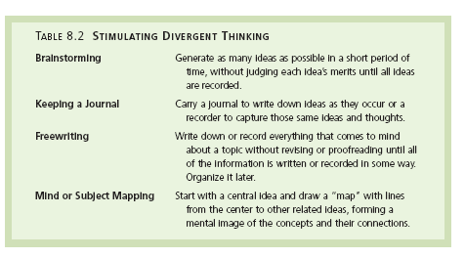
LO 8.6 Creative thinking
Menu

Slide 34
Giftedness
LO 8.11 Giftedness
Gifted - the 2 percent of the population falling on the upper end of the normal curve and typically possessing an IQ of 130 or above.
Menu

Slide 35
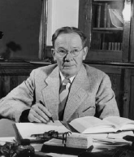
Does Giftedness Guarantee Success?
LO 8.12 Does intellectually gifted guarantee success
Terman conducted a longitudinal study that demonstrated that gifted children grow up to be successful adults for the most part.
  Terman’s study has been criticized for a lack of objectivity because he became too involved in the lives of his participants, even to the point of interfering on their behalf.
Menu

Slide 36
Theories of Intelligence
LO 8.13 Theories of intelligence and how they differ
Spearman’s Theory
  g factor – the ability to reason and solve problems, or general intelligence.
  s factor – the ability to excel in certain areas, or specific intelligence.
Gardner’s Theory
  Multiple intelligences - ranging from verbal, linguistic, and mathematical to interpersonal and intrapersonal intelligence.
Menu

Slide 37
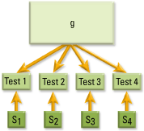
LO 8.13 Theories of intelligence and how they differ
Menu

Slide 38

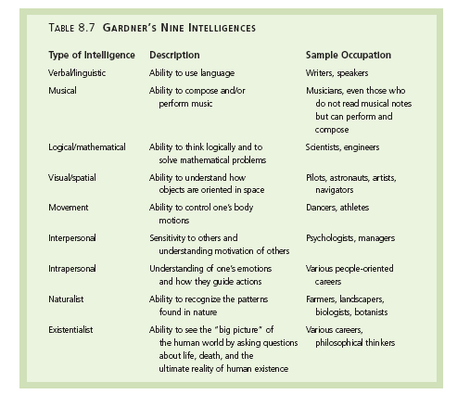
LO 8.13 Theories of intelligence and how they differ
Menu

Slide 39
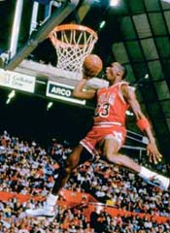
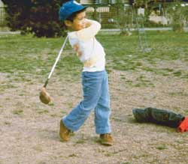
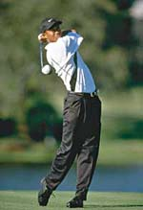
LO 8.13 Theories of intelligence and how they differ
According to Gardner, what kind of intelligence is being shown here?
Movement
Menu

Slide 40
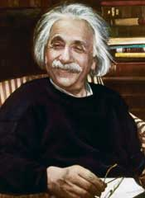
LO 8.13 Theories of intelligence and how they differ
According to Gardner, what kind of intelligence is being shown here?
Albert Einstein
Logical-Mathematical
Menu

Slide 41

LO 8.13 Theories of intelligence and how they differ
According to Gardner, what kind of intelligence is being shown here?
Visual-spatial
Menu

Slide 42
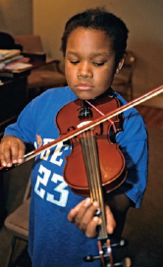
LO 8.13 Theories of intelligence and how they differ
According to Gardner, what kind of intelligence is being shown here?
Musical
Menu

Slide 43
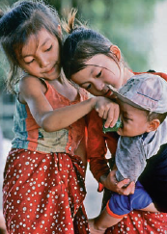
Theories of Intelligence
LO 8.13 Theories of intelligence and how they differ
Triarchic theory of intelligence - Sternberg’s theory that there are three kinds of intelligences: analytical, creative, and practical.
  Analytical intelligence - the ability to break problems down into component parts, or analysis, for problem solving.
  Creative intelligence - the ability to deal with new and different concepts and to come up with new ways of solving problems.
  Practical intelligence – the ability to use information to get along in life and become successful.
Menu

Slide 44
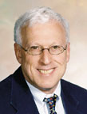
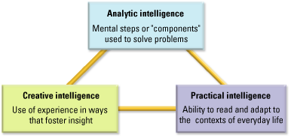
LO 8.13 Theories of intelligence and how they differ
Menu

Slide 45

Theories of Intelligence
LO 8.13 Theories of intelligence and how they differ
Emotional intelligence – the awareness of and ability to manage one’s own emotions as well as the ability to be self-motivated, able to feel what others feel, and socially skilled. Viewed as a powerful influence on success in life.
Menu

Slide 46
Heredity and Environment and Intelligence
LO 8.14 Influence of heredity and environment on intelligence
Stronger correlations are found between IQ scores as genetic relatedness increases.
Heritability of IQ is estimated at 0.50.
The Bell Curve - book that made widely criticized claims about the heritability of intelligence.
Menu

Slide 47

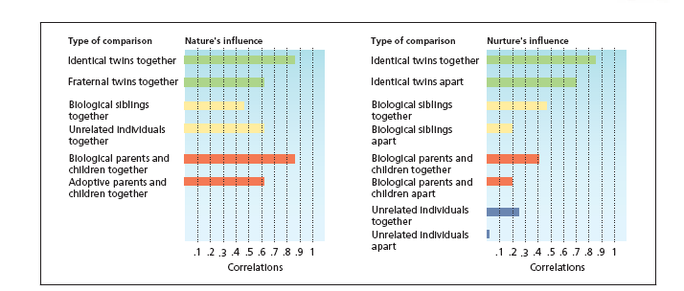
LO 8.14 Influence of heredity and environment on intelligence
Menu

Slide 48
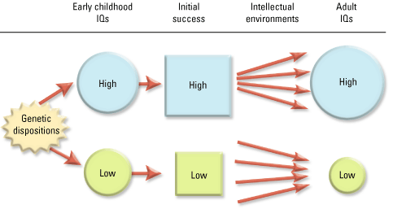
LO 8.14 Influence of heredity and environment on intelligence
Menu

Slide 49
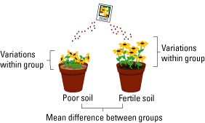
LO 8.14 Influence of heredity and environment on intelligence
Menu

Slide 50
Language
LO 8.15 Language
Language - a system for combining symbols (such as words) so that an unlimited number of meaningful statements can be made for the purpose of communicating with others.
Menu

Slide 51
Elements and Structure of Language
LO 8.16 Elements and structure of intelligence
Grammar - the system of rules governing the structure and use a of language.
Syntax - the system of rules for combining words and phrases to form grammatically correct sentences.
Morphemes - the smallest units of meaning within a language.
  Semantics - the rules for determining the meaning of words and sentences.
Menu

Slide 52

Elements and Structure of Language
LO 8.16 Elements and structure of intelligence
Phonemes - the basic units of sound in language.
Pragmatics - aspects of language involving the practical ways of communicating with others, or the social “niceties” of language.
Menu

Slide 53
Language and Cognition
LO 8.17 Language’s influence on thinking
Linguistic relativity hypothesis - the theory that thought processes and concepts are controlled by language.
Cognitive universalism – theory that concepts are universal and influence the development of language.
Menu

Slide 54
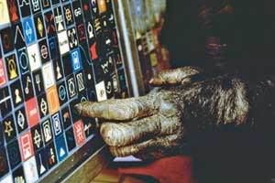
Animal Language
LO 8.18 Animal capability of learning language
Studies have been somewhat successful in demonstrating that animals can develop a basic kind of language, including some abstract ideas.
Controversy exists over the lack of evidence that animals can learn syntax, which some feel means that animals are not truly learning and using language.
Menu

Slide 55
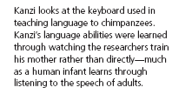
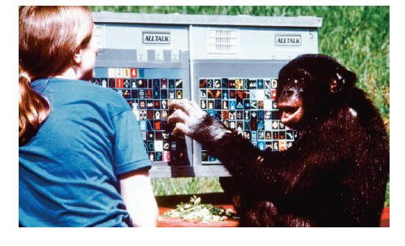
LO 8.18 Animal capability of learning language
Menu

Slide 56
Ways to Improve Thinking
LO 8.19 Ways to improve thinking
Mental activity that requires creativity and the use of memory abilities, such as working crossword puzzles and reading books, can help to keep the brain fit.
Menu

